Slide 1
PJ PARENTS MEETING
January 15th 2025 (6-8pm)

Slide 2
AGENDA
Welcome and call to order: Claudia Chavez and Barry Nguyen
Approval of last meeting minutes (Nov 7 2024)
3. Land Acknowledgement
4. AI in schools (Ms. Cari Wilson)
5. Principal ’s Report (Mme. Tara Zielinski)
6. PAC Financial Update
7. PAC events
8. Volunteers and Budget Implications
9. Adjournment

Slide 3
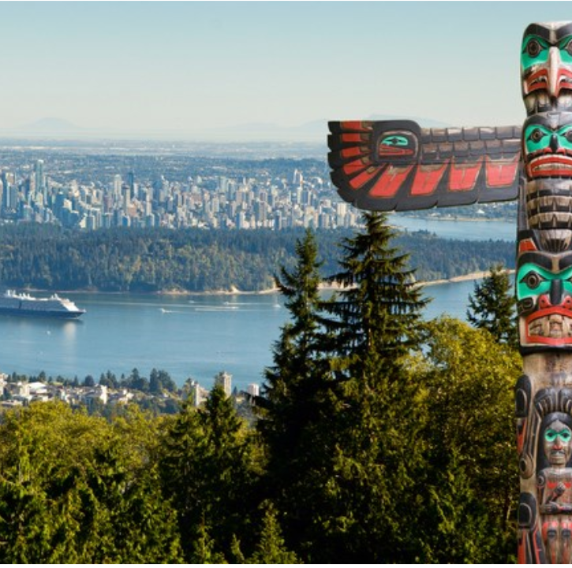
Land Acknowledgement
We would like to begin this meeting by acknowledging that the land on which this meeting is being held is the unceded and traditional territories of the Squamish, Tsleil-Waututh and Musqueam indigenous nations. We are grateful for the opportunity to live, learn, work and play on these ancestral lands as we continue to show our respect and acknowledgement for being on these territories.

Slide 4
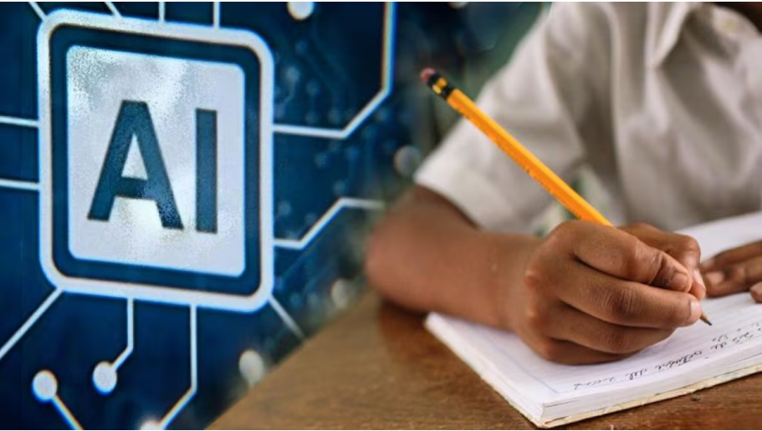
AI in Schools
Ms. Cari Wilson is West Vancouver School District’s District VP of Innovation and Technology and brings a wealth of experience and expertise across many areas of technology and is a lead in this area in BC. She also teaches a new AI course at UBC, titled, “AI in K-12 Education: Classroom of the Future”. Please join us for this informative parent education session titled: “AI in Schools: What West Vancouver is Doing and What You Need to Know as Parents in this Evolving Digital Era”

Slide 5
Principal’s Report

Slide 7
PAC Financial Updates
We’ve been spending more than we’ve been earning.
Even with the surplus, we will eventually run out if we continue on this trajectory.
We’ve shrunk our fundraisers due to lack of volunteers.
https://www.ecolepjpac.com/wp-content/uploads/2024/09/240831-PJ-PAC-Budget-2024-2025.pdf

Slide 8
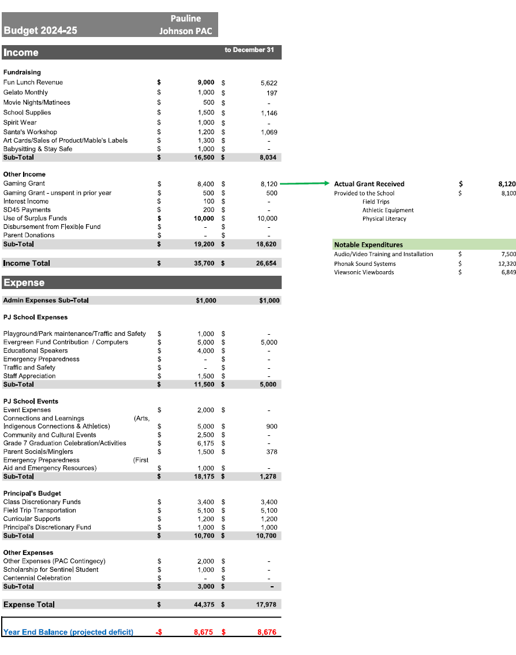
We are tracking more or less to budget so far, but because Fun Lunch revenues are front loaded, things often change late in the second semester. Some categories have revenues that are not reported in this document, they'll be captured in next update when various deposits have been separated. The big unknown is the needs for the Gala. We have some generic events funds that we can use for deposits, but they're relatively modest. We are really counting on this revenue to come in and address our projected deficit, which remains significant. No other major surprises expense or revenue wise.

Slide 9
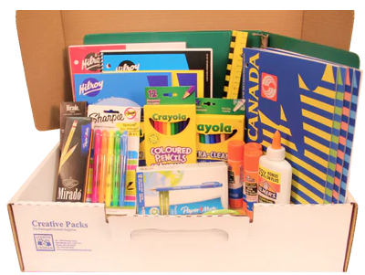
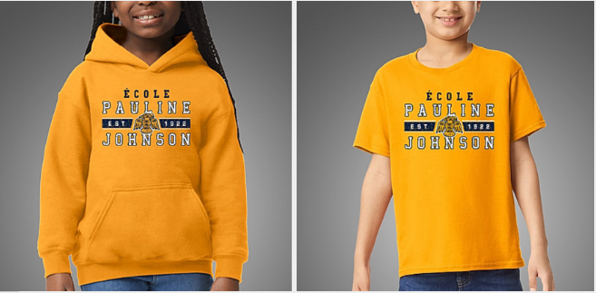
PAC events ecolepjpac.com
Past Events:
Nov 29: Pizza day:
Dec. 5, 12, 20: Hot Chocolate. (Thank you sponsors)
Dec 19: Santa’s Workshop. (Jenny led this initiative for the last 8 years!)
Jan 10: Popsicle Friday
New upcoming events:
Jan. 13-17: Traffic Blitz
Jan 15: PAC meeting
Jan. 31: Pizza Day
Feb 21: Spirit Wear day (Vintage sale coming!)
TBDs: Bingo, Movie Matinee, Dance #2, Gala,
Year-end celebration.

Slide 10
Volunteers and Budget Implications

Slide 11
Adjournment Next PJ Parents Meeting on Feb. 13 (6-8pm) Virtual only ecolepjpac.com info@ecolepjpac.com

